Slide 1

Sentiment analysis of reviews
SOLELY FOR PURPOSES OF FORAGE WORK EXPERIENCE
Using Natural Language Processing tools
Using a Python code, 1000 reviews were scraped from airlinequality.com
In order to get valuable insights from data, it was decided to perform a sentiment analysis using a Vader model. Following the analysis, the most popular words were identified, as well as bigrams and trigrams were created to identify the most common word pairs. Bigrams and trigrams would help determine potential issues that should be targeted.

Slide 2
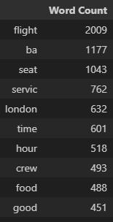
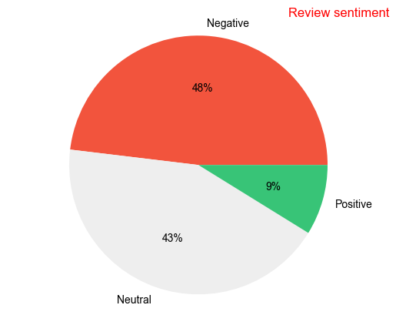
Sentiment analysis of 1000 reviews (with prior cleaning) produced the following results:
Top 10 of the most popular words indicate that most of the reviews include the words seat, service, London, time, crew, food. It is possible that the issues affecting the negative sentiment are related to these words.
51% of reviews were negative.
48% of reviews were neutral.
Up to 1% of reviews were positive.

Slide 3
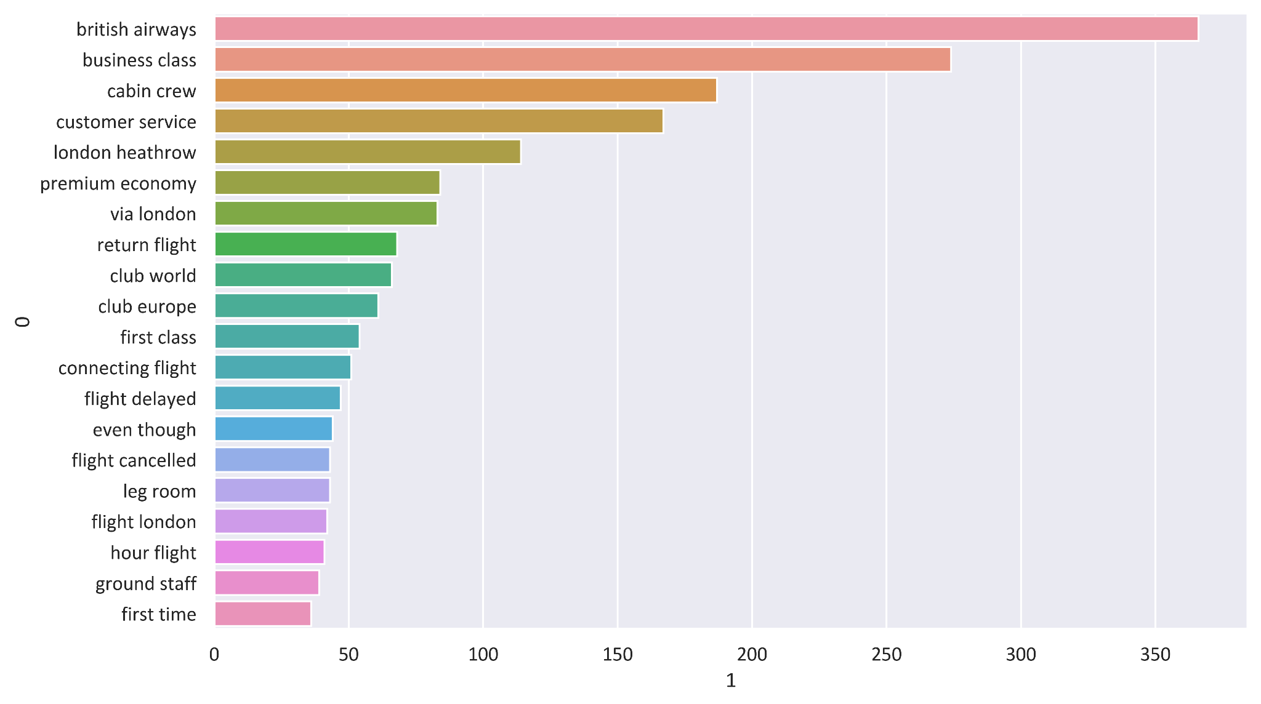
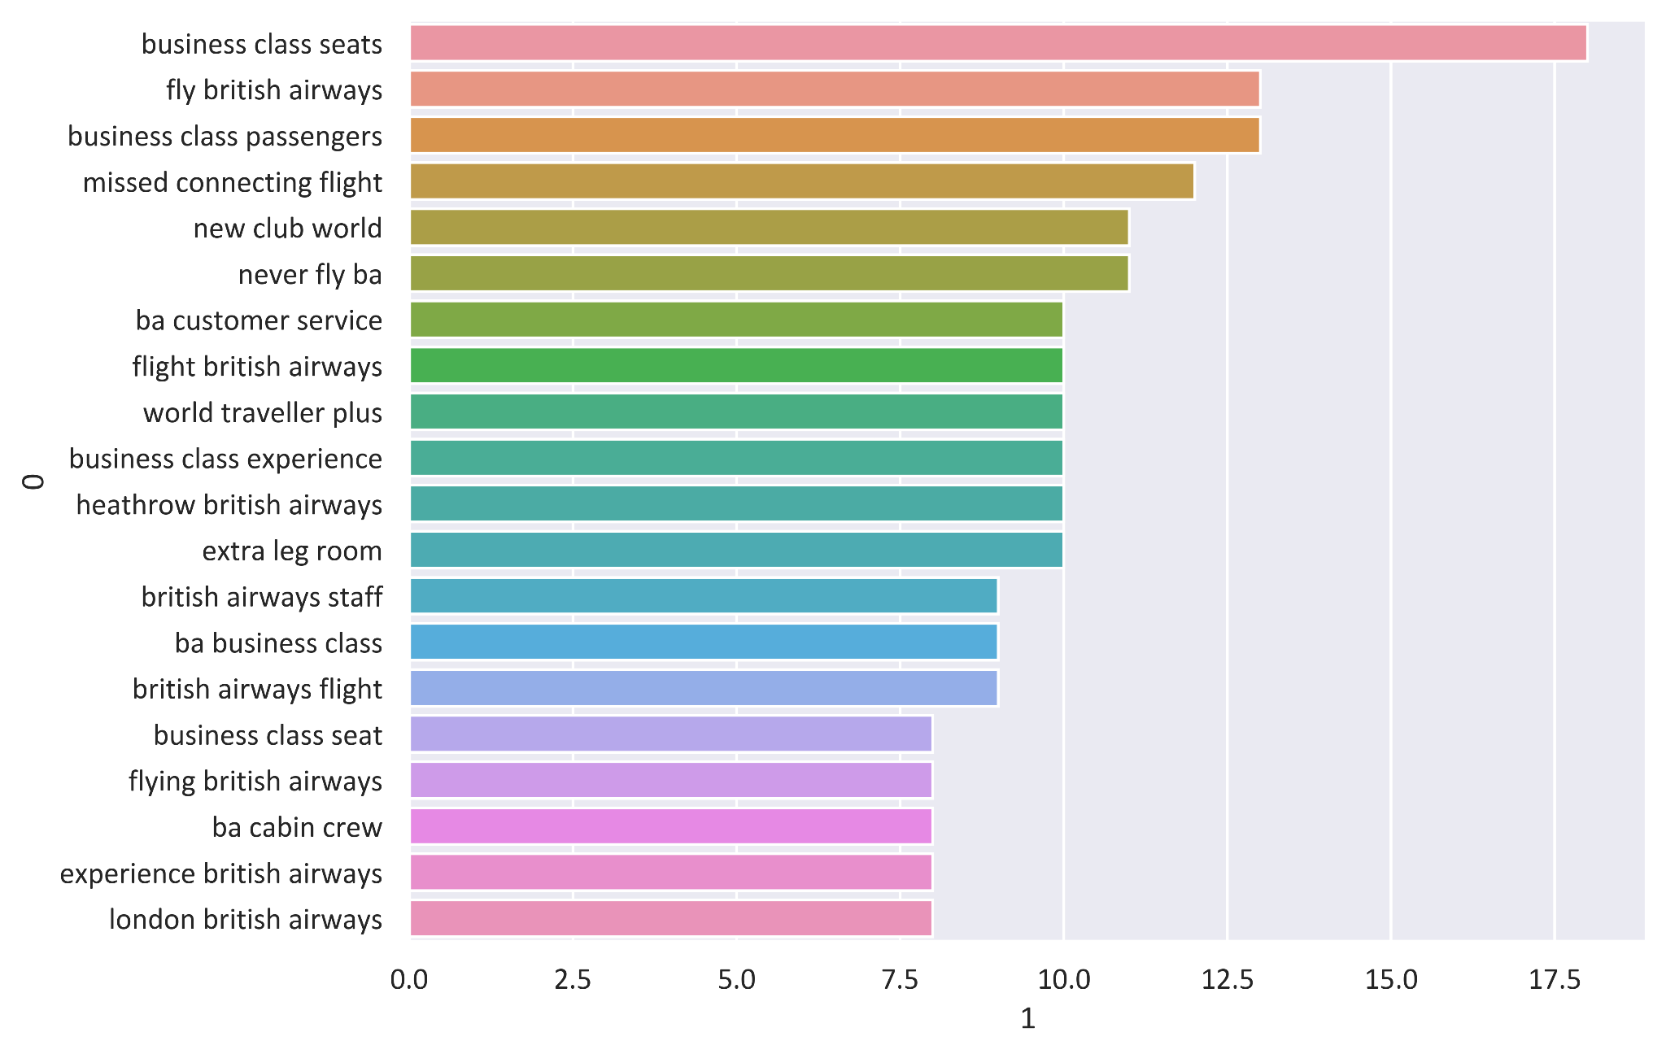
Bigram and trigram provide more context on the potential issues.
The potential issues might include:
Business class seats/experience
New club world
Customer service
Cabin crew
Flight delayed/cancelled

Slide 4
Issues in detail
After manual inspection of the reviews, customers did not like:
Business class seats arrangement, seating pattern, and narrow seats.
Club World service. Bugs in seats, noisy neighbours, crew cabin ran out of food.
Busy customer service lines, long waiting time for issue to be resolved. Staff need better training, knowledge and manners.
Cabin crew sometimes were “abrupt and surly”.
Check in staff in Heathrow airport are sometimes rude, shouting at the passengers waiting in line.

